Slide 1

AUGMENTED
REALITY
Manimaran N
Roll no:31

Slide 2
WHAT IS
AUGMENTED REALITY?

Slide 3
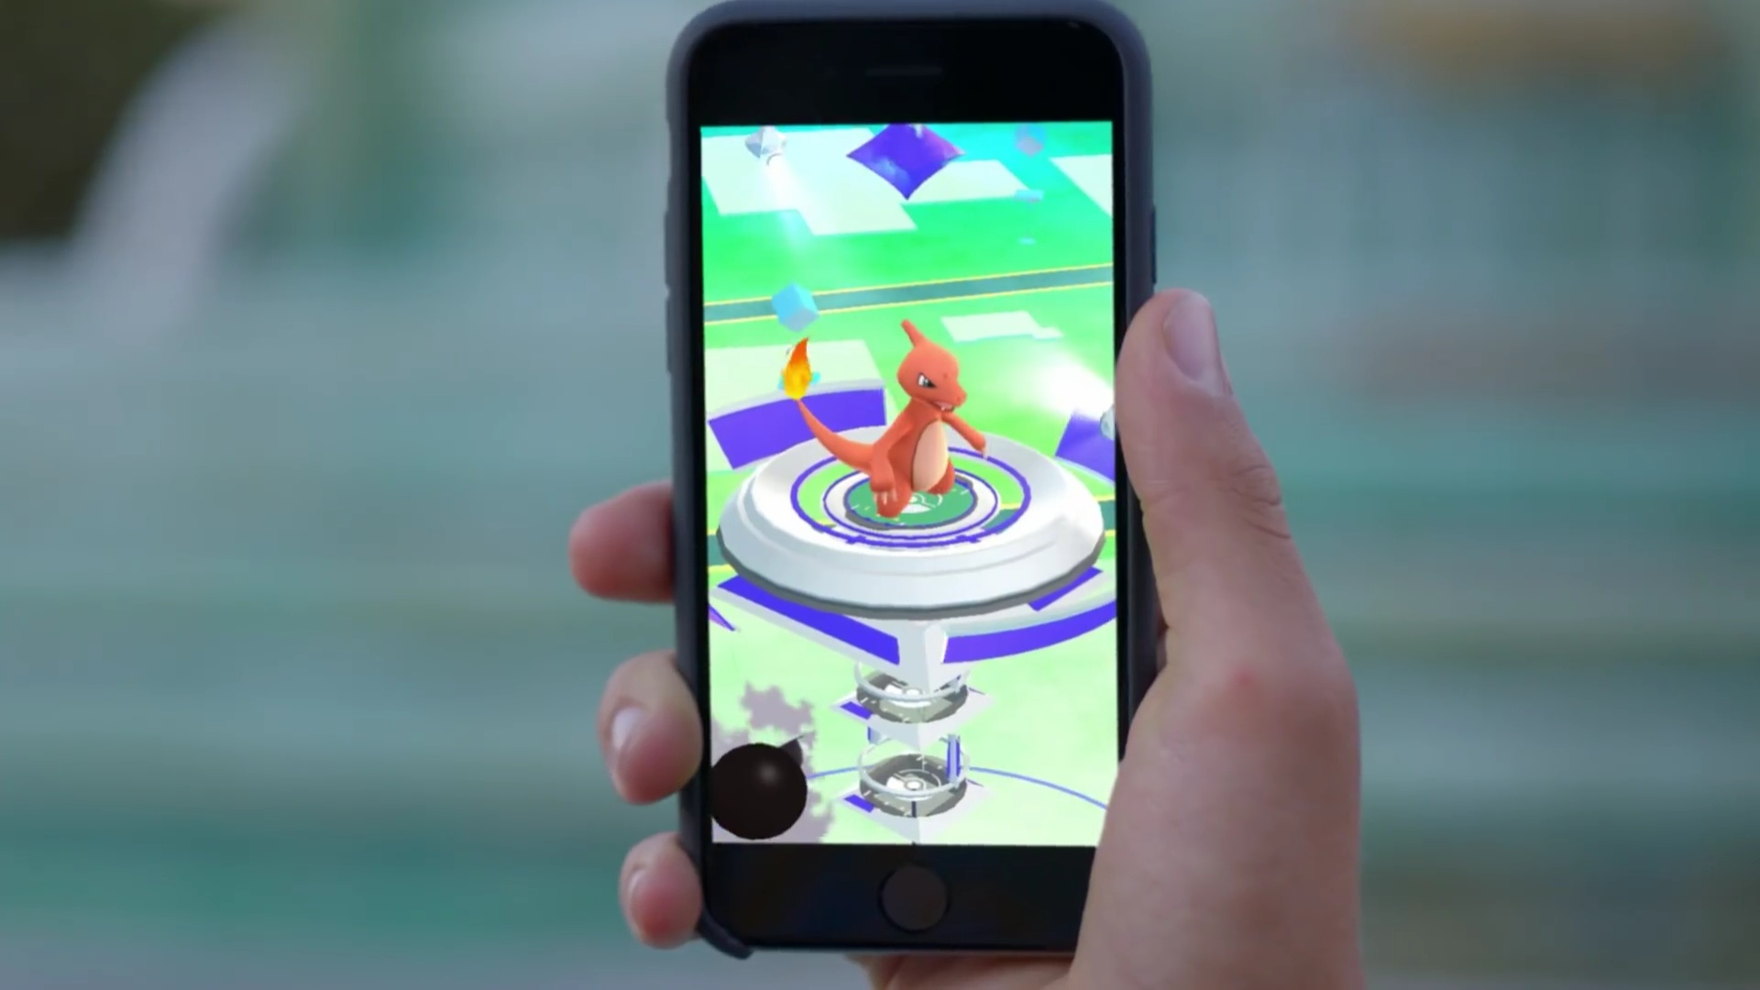
POKEMON GO

Slide 4
Augmented reality is the integration of digital information with user’s environment in the real time , ie augmented reality uses the existing environment and overlays new information on the top of it.

Slide 5
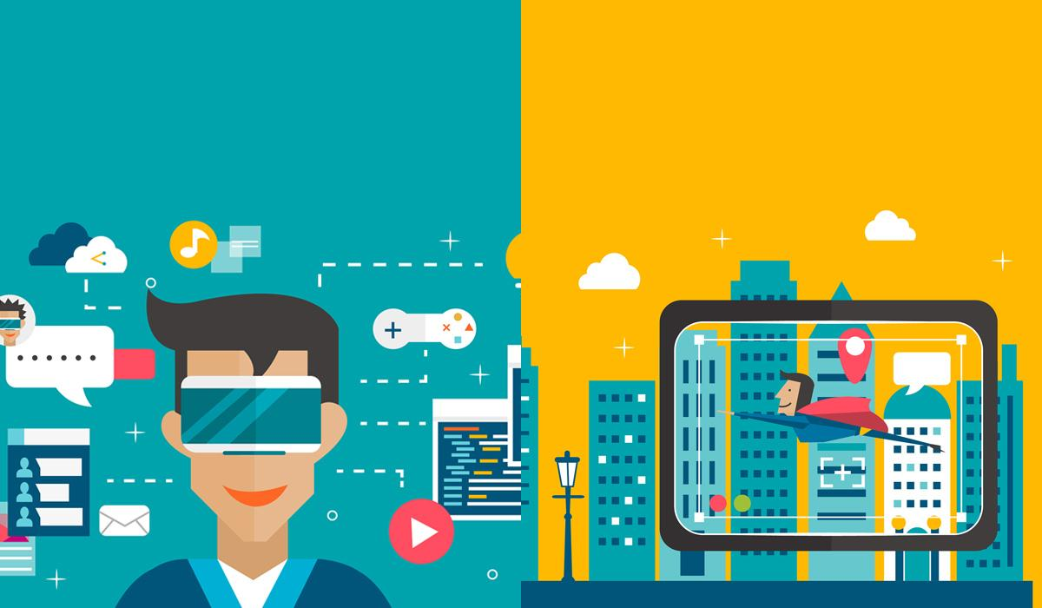
Virtual Reality (VR) is a digital recreation
Of the environment around the user
Augmented Reality (AR) overlays virtual
Elements in the real world

Slide 6
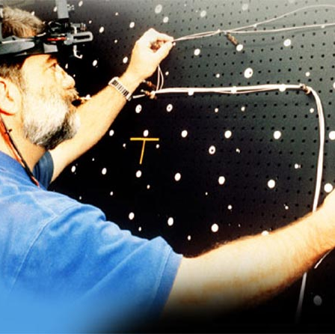
ORIGIN
The year 1992 marked the birth of the term “Augmented Reality”. This term first appeared in the work of caudell and Mizell [1992] at Boeing, which sought to assist workers in an airplane factory by displaying wire bundle assembly schematics in a see-through HMD

Slide 7

TECHNOLOGY...

Slide 8

HARDWARE
Hardware components for Augmented Reality are: processor , display, sensors and input devices.
Modern mobile computing devices like smart phones and tablet computers contain these elements which often include a camera and MEMS sensors such as accelerometer, GPS ,and solid state compass, making them suitable AR platform.

Slide 9

DISPLAY
Various technologies are used in Augmented Reality rendering including optical projection systems , monitors , handheld devices , and display systems worn on the human body.
A HMD is a display device paired to the forehead such as harness or helmet.modern HMDs often employ sensors for six degrees of freedom monitoring that allow the system to align virtual information to the physical world and adjust accordingly with user's head movements.

Slide 10
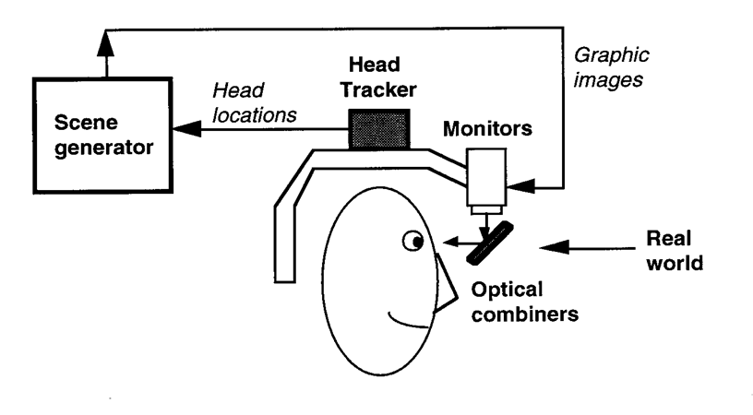
HMD

Slide 11
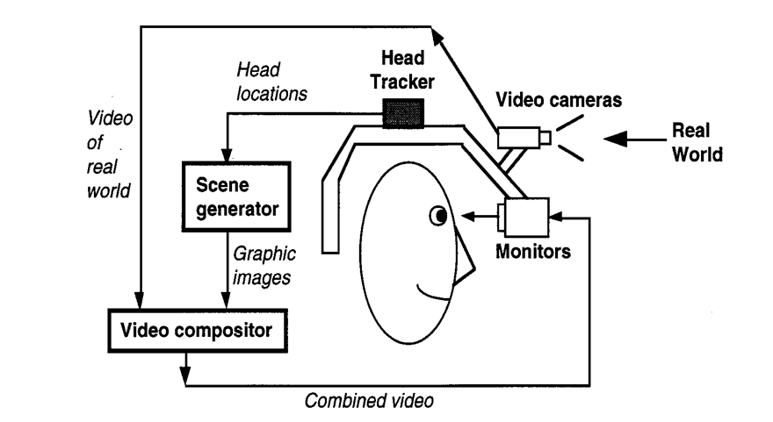

Slide 12
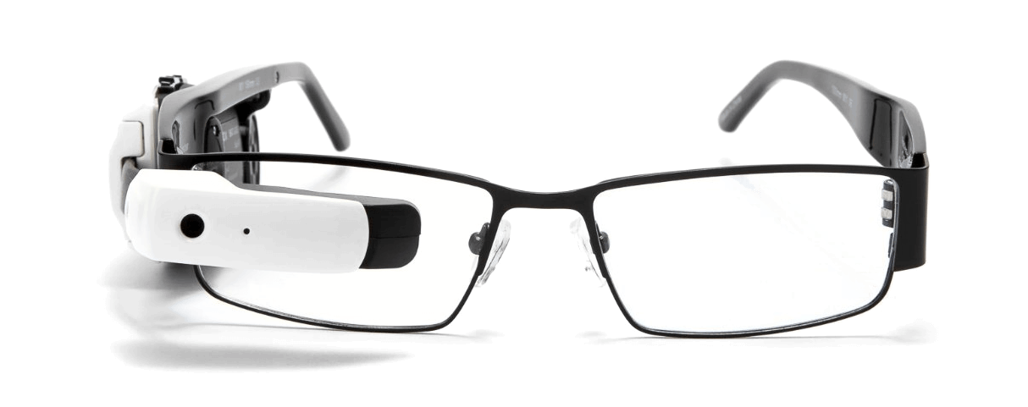
EYEGLASSES
AR Displays can be rendered on devices resembling eyeglasses .
Versions includes eyewear that employes camera to intercept the real world view and redisplay its augmented view through the eyepieces and devices and devices in which the AR imaginary is projected through or reflected off the surfaces of the eyewear lens pieces.

Slide 13

HANDHELD
Handheld displays employ a small display that fits in a user's hand .
Al handheld AR solutions to date opt for video see-through Initially handheld AR employed fiducial markers and later GPS units and MEMS sensors such as digital compasses and six degrees of freedom accelerometer- gyroscope .
Today SLAM markerless trackers such as PTAM are starting to come into use.

Slide 14
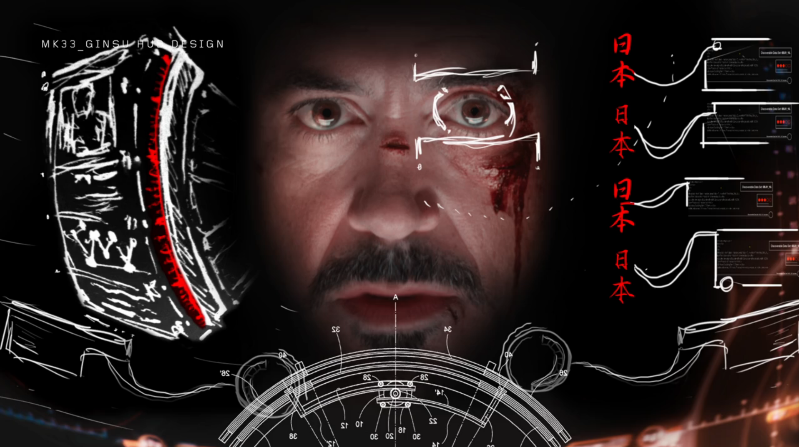
HUD

Slide 15
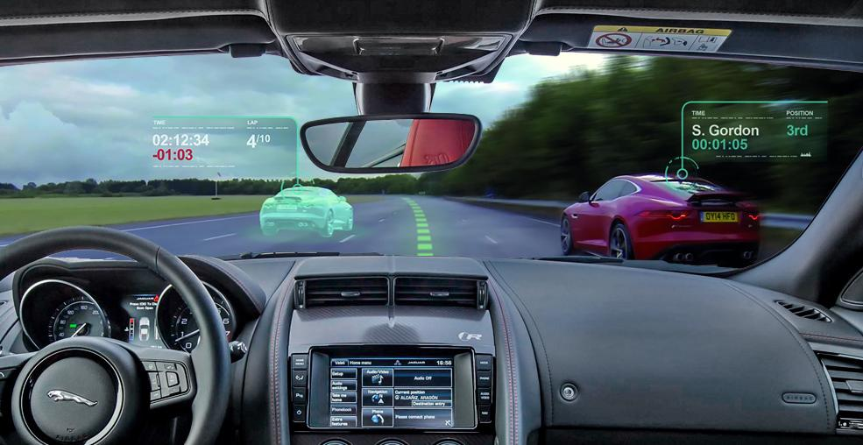
HEAD UP DISPLAY

Slide 16
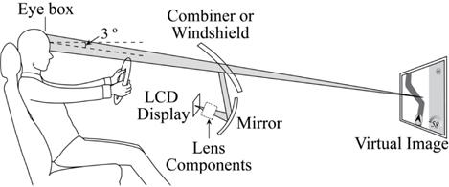

Slide 17
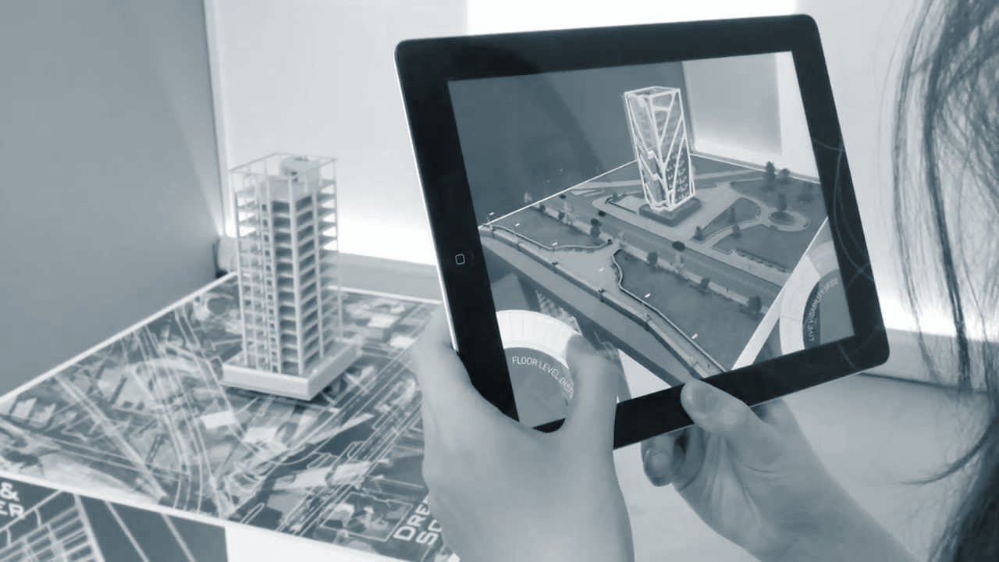
SPATIAL AUGMENTED REALITY

Slide 18
SPATIAL AUGMENTED REALITY
Spatial Augmented Reality Augments real world objects and scenes without the use of special displays such as monitors , HMD , or hand held devices . SAR makes use of digital projectors to display graphical information about physical objects .
The Key difference in SAR is that the display is separated from the users of the system . Because the displays are not associated with each user's, SAR scales naturally up to group of users , thus allowing for collocated collaboration between users.

Slide 19

TRACKING
Modern mobile augmented-reality systems use one or more of the following tracking technologies .
digital cameras and or other optical sensors , accelerometers, GPS , gyroscopes , solid state compass , RFID and wireless sensors
These technologies offer Varying levels of accuracy and precision.

Slide 20
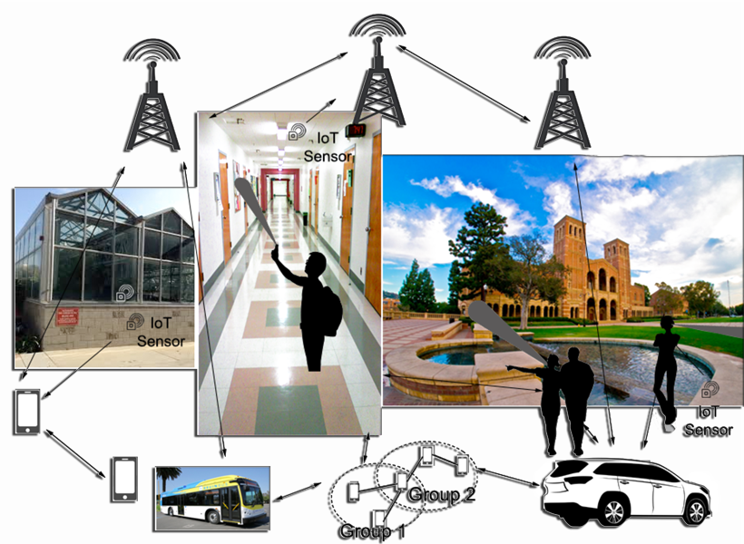
NETWORKING
Mobile augmented reality applications are gaining popularity due to the wide adoption of mobile and especially wearable devices.
However , they often rely on computationally intensive computer vision algorithms with extreme latency requirements .
To compensate for the lack of computing power , offloading introduces new constraints in applications, especially in terms of latency and bandwidth Although there are plethora of real time multimedia transport protocols there is a need for support from network infrastructure as well.

Slide 21
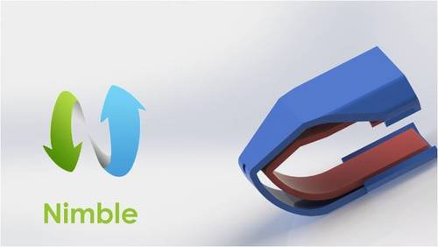
INPUT DEVICES
Techniques include speech recognition systems that translate a user's spoken words into computer instructions and gesture recognition systems that can intercept a user's body movements by visual detection or from sensors embedded in a peripheral device such as a wand , stylus , pointer , glove or other body wear

Slide 22
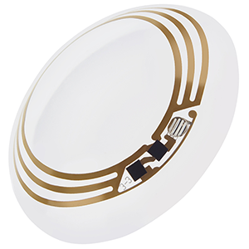
CONTACT LENS
They are under development.
Tese bionic contact lenses might contain the elements for display embedded into lens including integrated circuitry, LEDs and the antenna for wireless communication .
in 1999 and later in 2010/2011 different versions of contact lenses were reported .
Another version is in development for the US military ,is designed to function with AR spectacles , allowing soldiers to focus on close to the eye AR images on the spectacles and distant real world objects at the same time
https://www.youtube.com/watch?v=lK_cdkpazjI

Slide 23
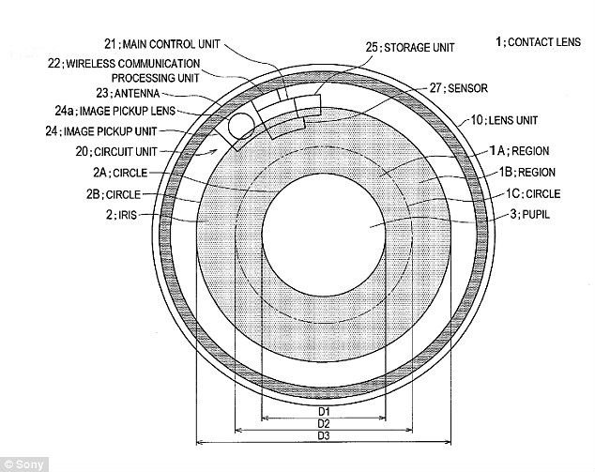

Slide 24
SOFTWARE &
ALGORITHMS
A key measure of AR systems is how realistically they integrate augmentations with the real world .
The software must derive real world coordinates , independent from the camera , from camera images.
The process is called image registration which uses different methods of computer vision , mostly related to video tracking. Many computer vision methods of AR are inherited from visual odometry.

Slide 25






SOFTWARE &
ALGORITHMS

Slide 26
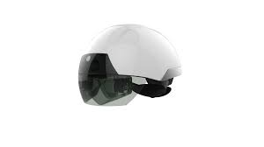
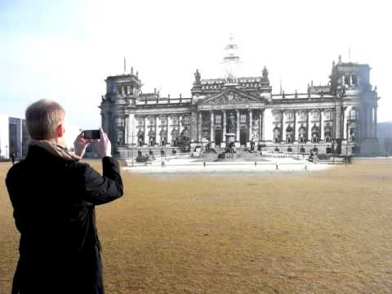
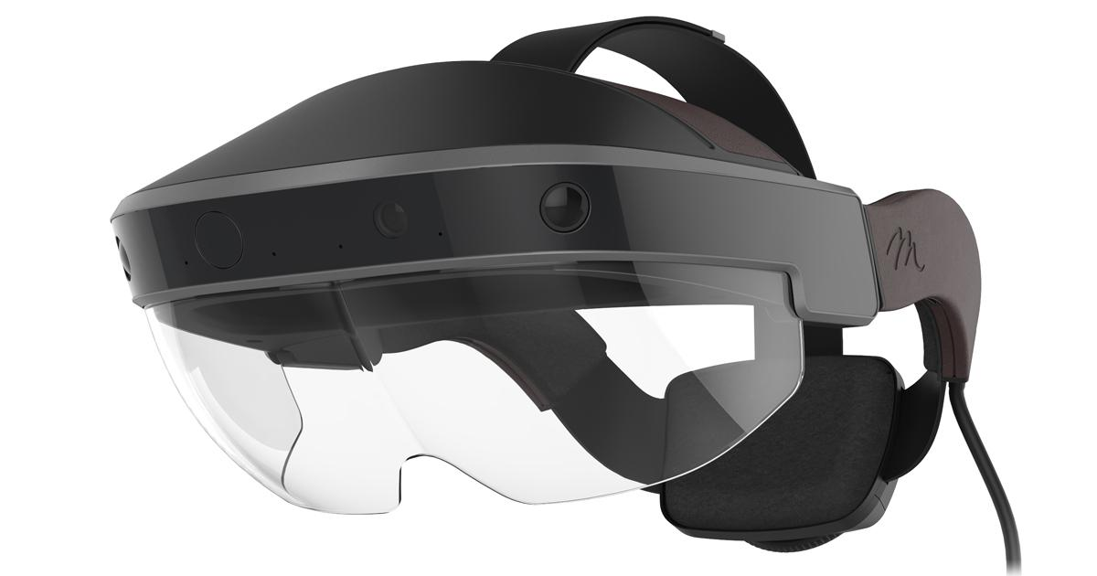
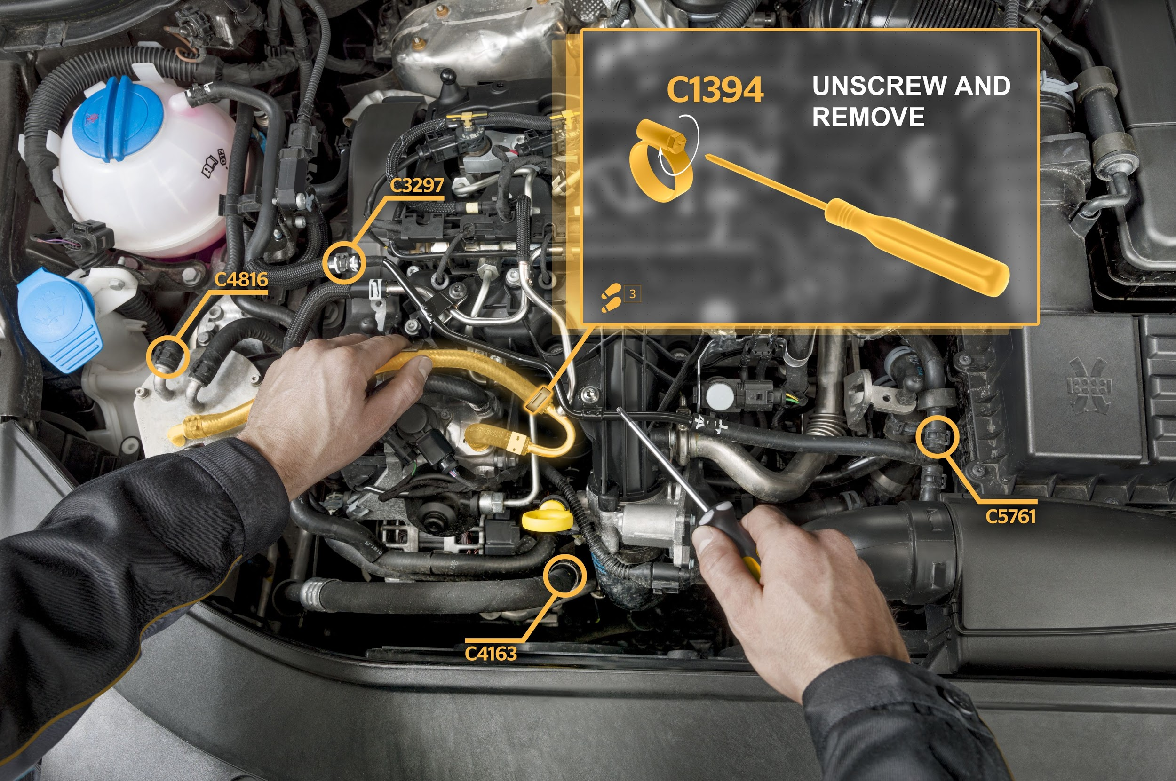


APPLICATIONS
Handheld AR Equipments
AR Headsets
SightSeeing in Augmented Reality
Maintenance and repair
AR Applications
AR Gaming

Slide 27




Military AR Uses
Medical AR Uses
Advertising and Promotions
AR apps for Navigation

Slide 28
LET’S FEEL AUGMENTED REALITY
https://www.youtube.com/watch?v=lK_cdkpazjI

Slide 29
THANK YOU...
© inspire

Slide 30
APPLICATIONS
Handheld AR Equipments
SightSeeing in Augmented Reality
AR Headsets
Maintenance and repair
AR Applications
AR Gaming
Military AR Uses
Advertising and Promotions
Medical AR Uses
AR apps for Navigation

